Slide 1

Analysis of Cultural beliefs based on popular venues
Esha Tulsian

Slide 2
Background
More than 195 countries in the world and 1000s of different cultures
A city’s layout is planned beforehand to reflect cultural traditions and values

Slide 3
Focus on 3 Cities of the World
New York City, USA
Toronto, Canada
Seoul, south Korea

Slide 4
Business Problem
Compare the 3 cities and how each represents their unique culture
Analyze which venue type is most common

Slide 5
Interest
Businesses: understand the culture and what the population likes
General Public: learn about cultural comparisons

Slide 6
Data Sources
NYC
Postal Code and Geospatial Data
Toronto
Postal Code
Geospatial Data
Seoul
Postal Code
Latitude and Longitude data from Geopy
Foursquare API
Foursquare API
Foursquare API

Slide 7
Data Cleaning

Slide 8
Data Cleaning Steps
NYC
Select columns “Borough”, “Neighborhoods”, “Latitude”, and “Longitude”
Create a dataframe
Toronto
Scrape Wikipedia and create dataframe
Clean data
Remove NA values
Make sure each row is a different postcode
Seoul
Scrape Wikipedia
Use Geopy Library to get Latitude and Longitude Data

Slide 9
Features
NYC
Borough
Neighborhood
Toronto
Borough
Latitude
Seoul
Postcode
Latitude
Longitude
Neighborhood
Postcode
Longitude
District
Latitude
Longitude
5 Unique Boroughs
306 Unique Neighborhoods
10 Unique Boroughs
103 Unique Postcodes
25 Unique Districts

Slide 10
Exploratory Data Analysis

Slide 11
Steps
Plotted Neighborhoods on a Map
Used Foursquare API to get venue data

Slide 12
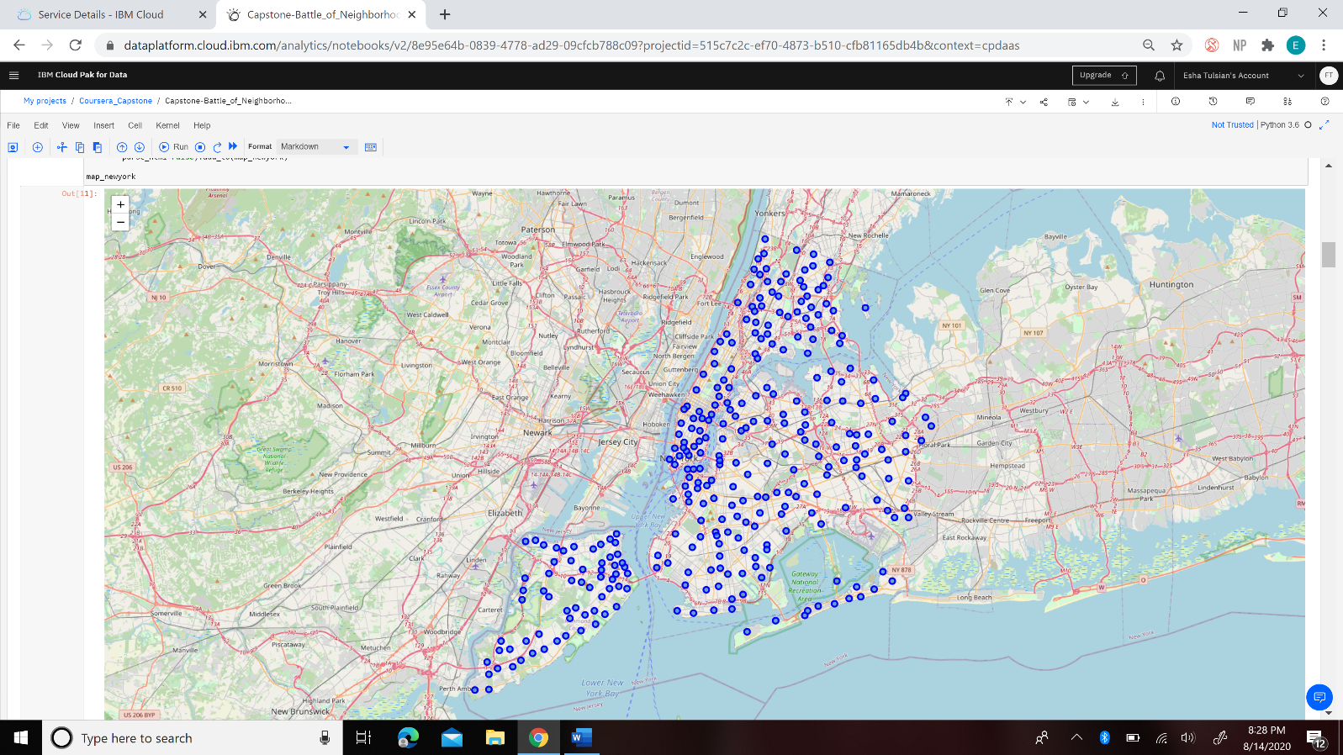
New York City
10032 Total Venues
421 Unique Venue Categories

Slide 13
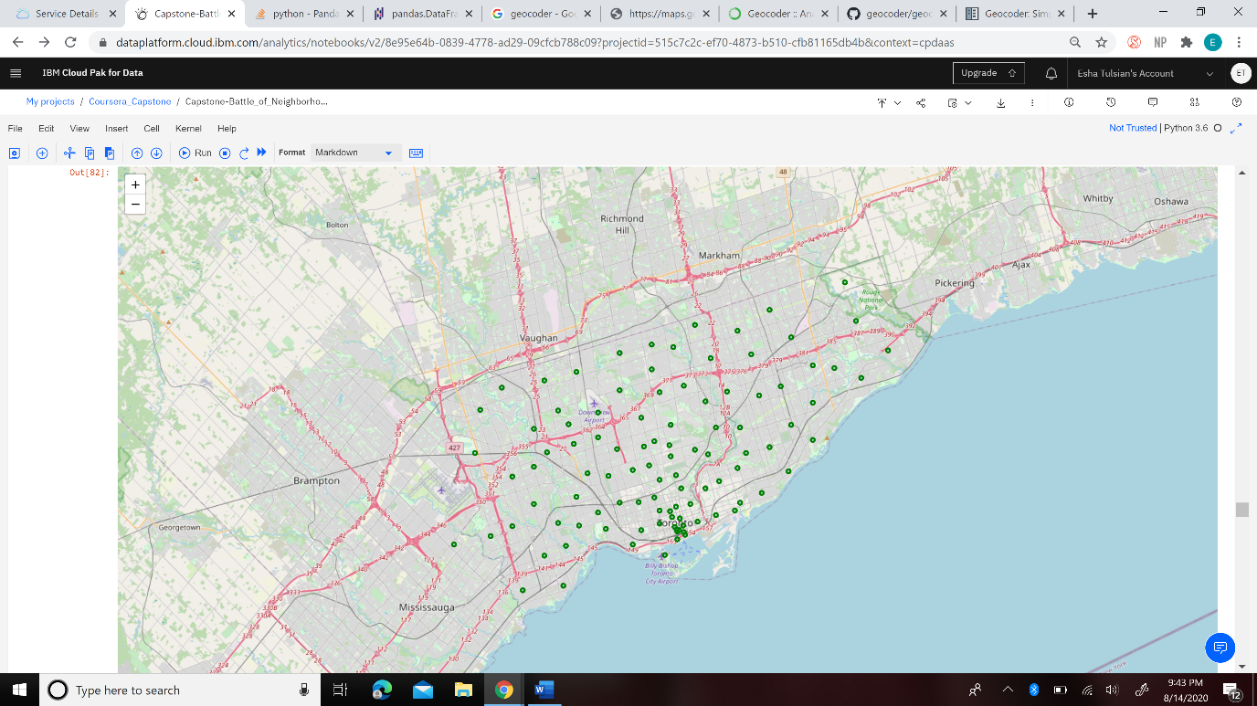
Toronto
2124 Total Venues
269 Unique Venue Categories

Slide 14
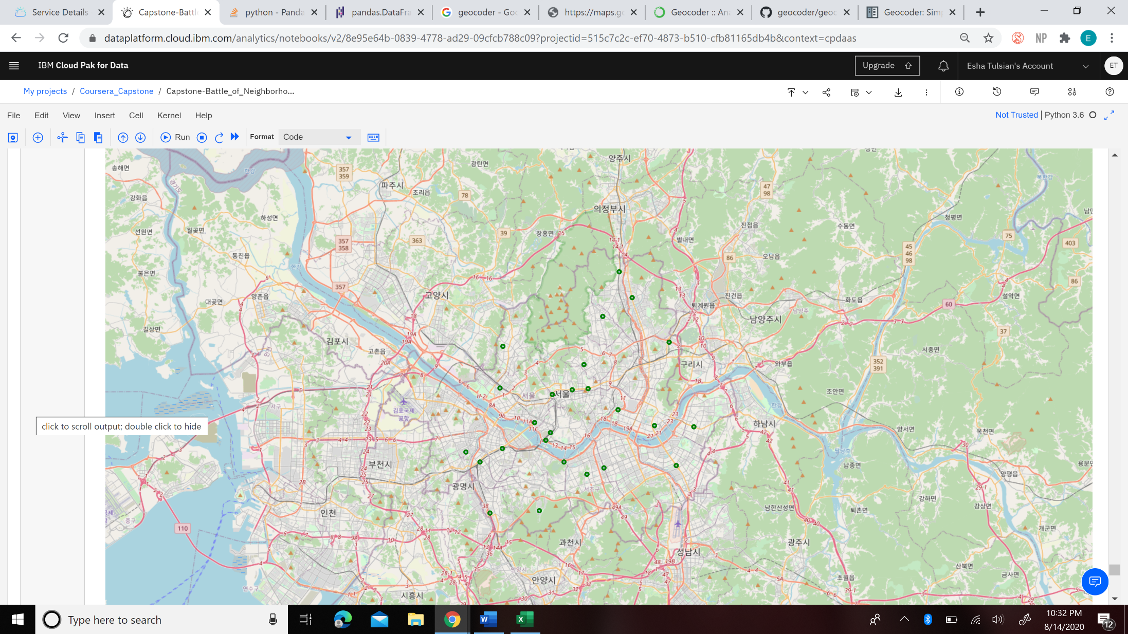
Seoul
791 Total Venues
124 Unique Venue Categories

Slide 15
Results

Slide 16
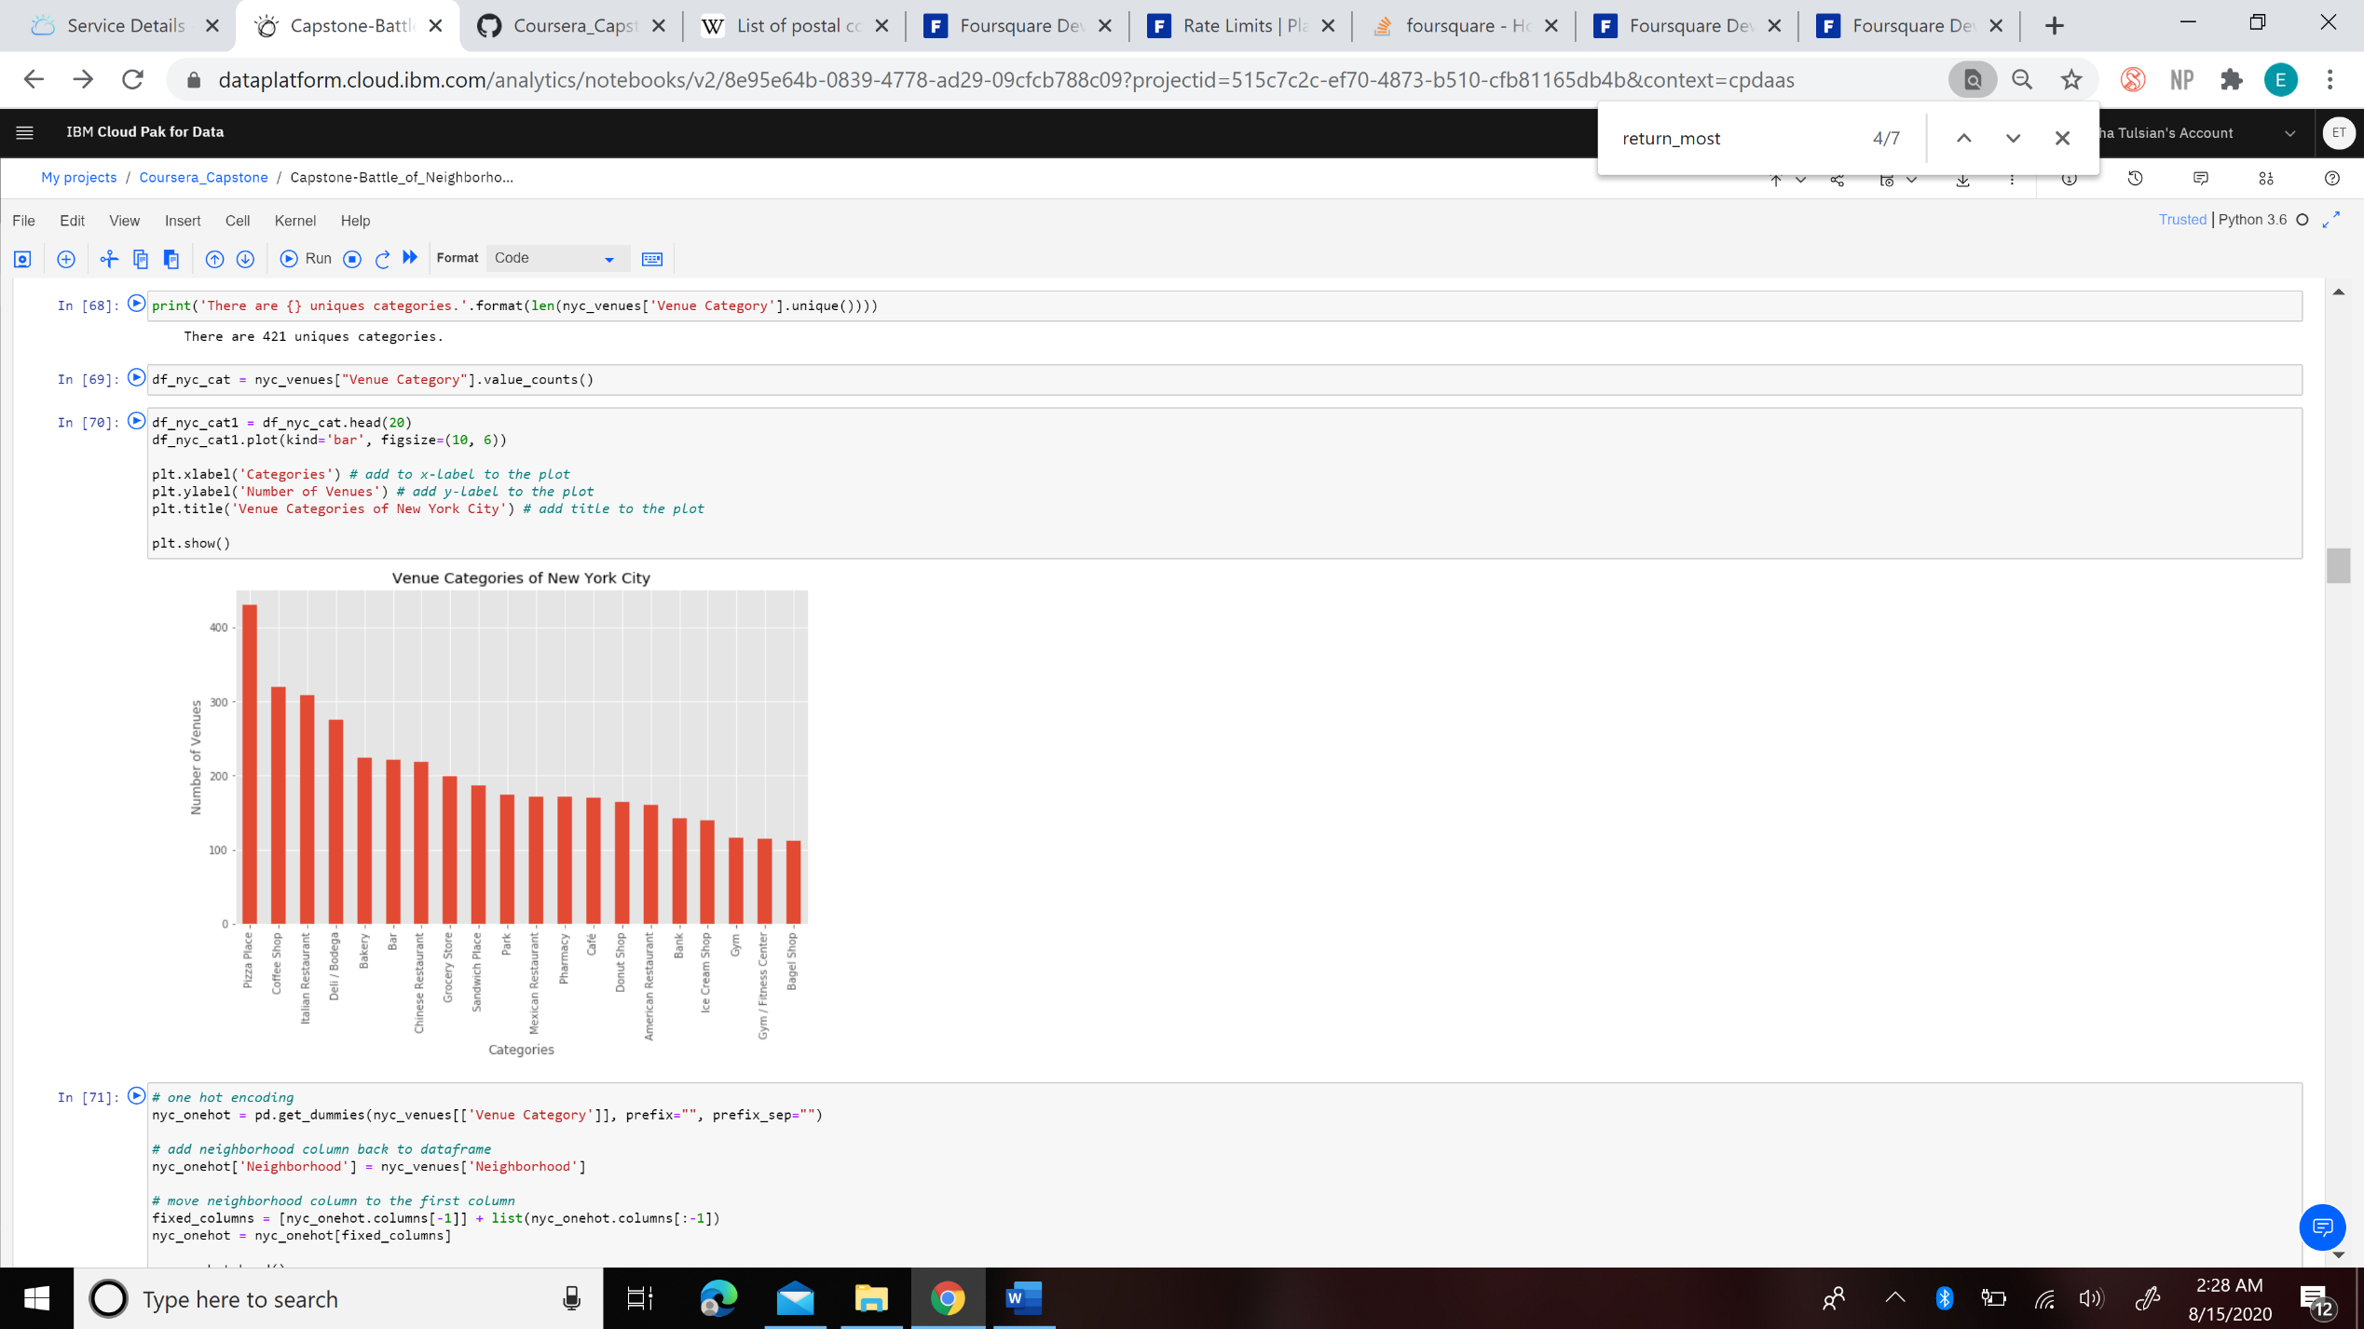
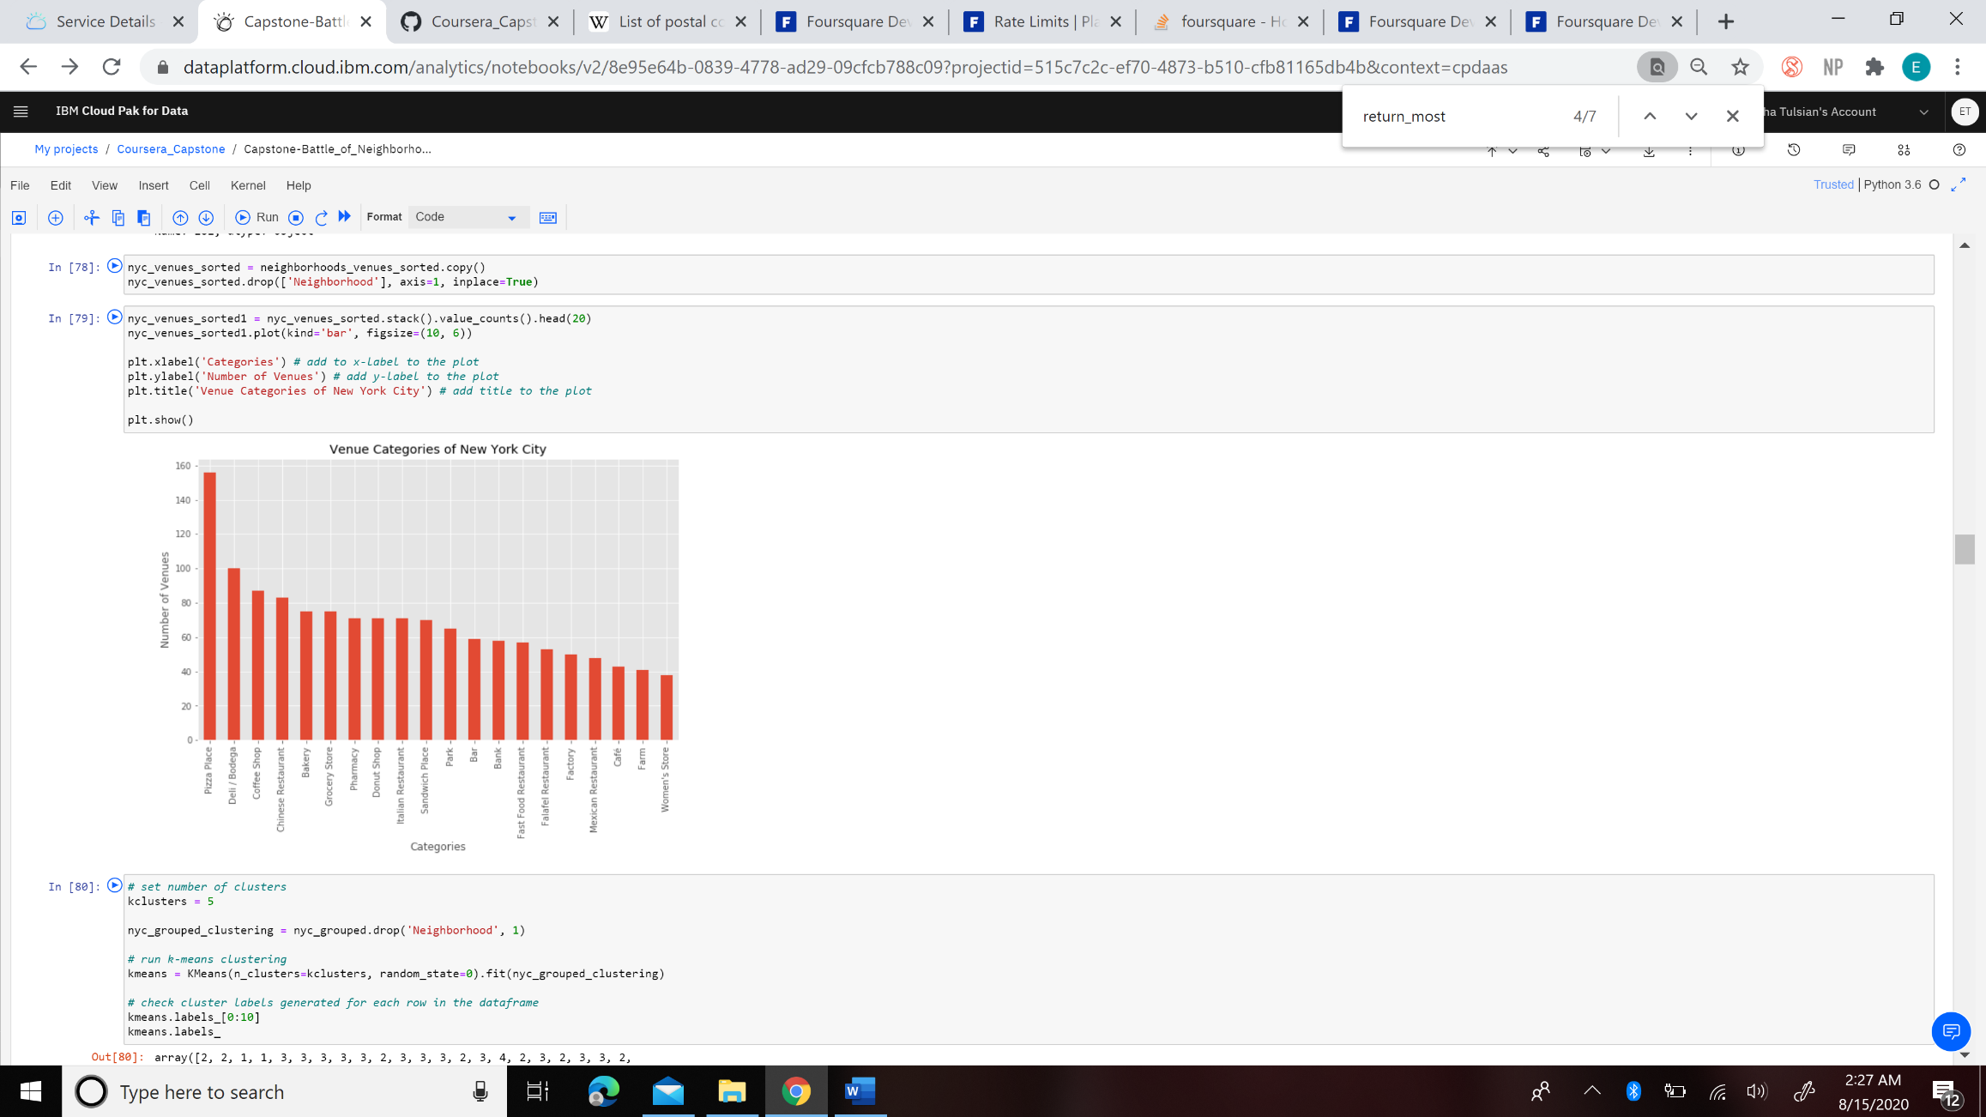
New York City
Top 20 Most Common Overall Venue Types
Top 20 Venue Types after looking at Top 10 Venues of Each Neighborhood

Slide 17
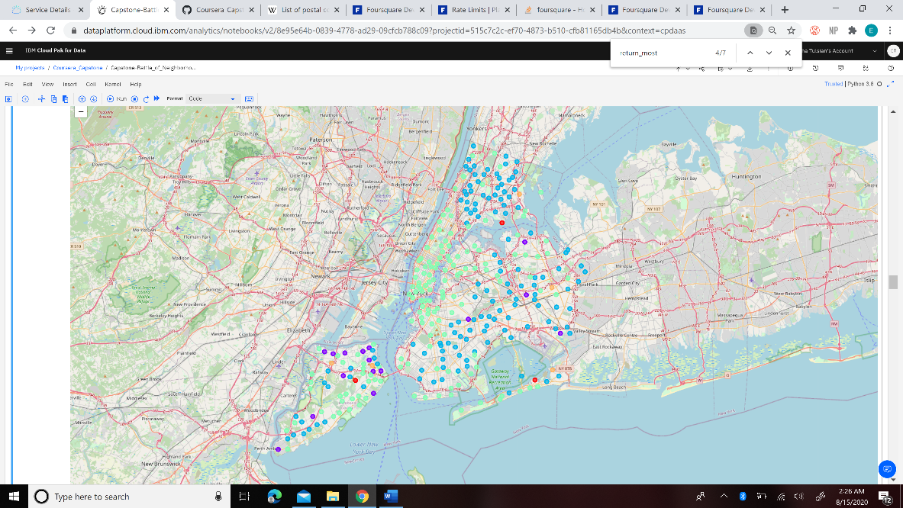
New York City
Cluster 0
Red
3 Neighborhoods
Cluster 1
Purple
16 Neighborhoods
Cluster 2
Blue
133 Neighborhoods
Cluster 3
Green
148 Neighborhoods
Cluster 4
Orange
5 Neighborhoods

Slide 18
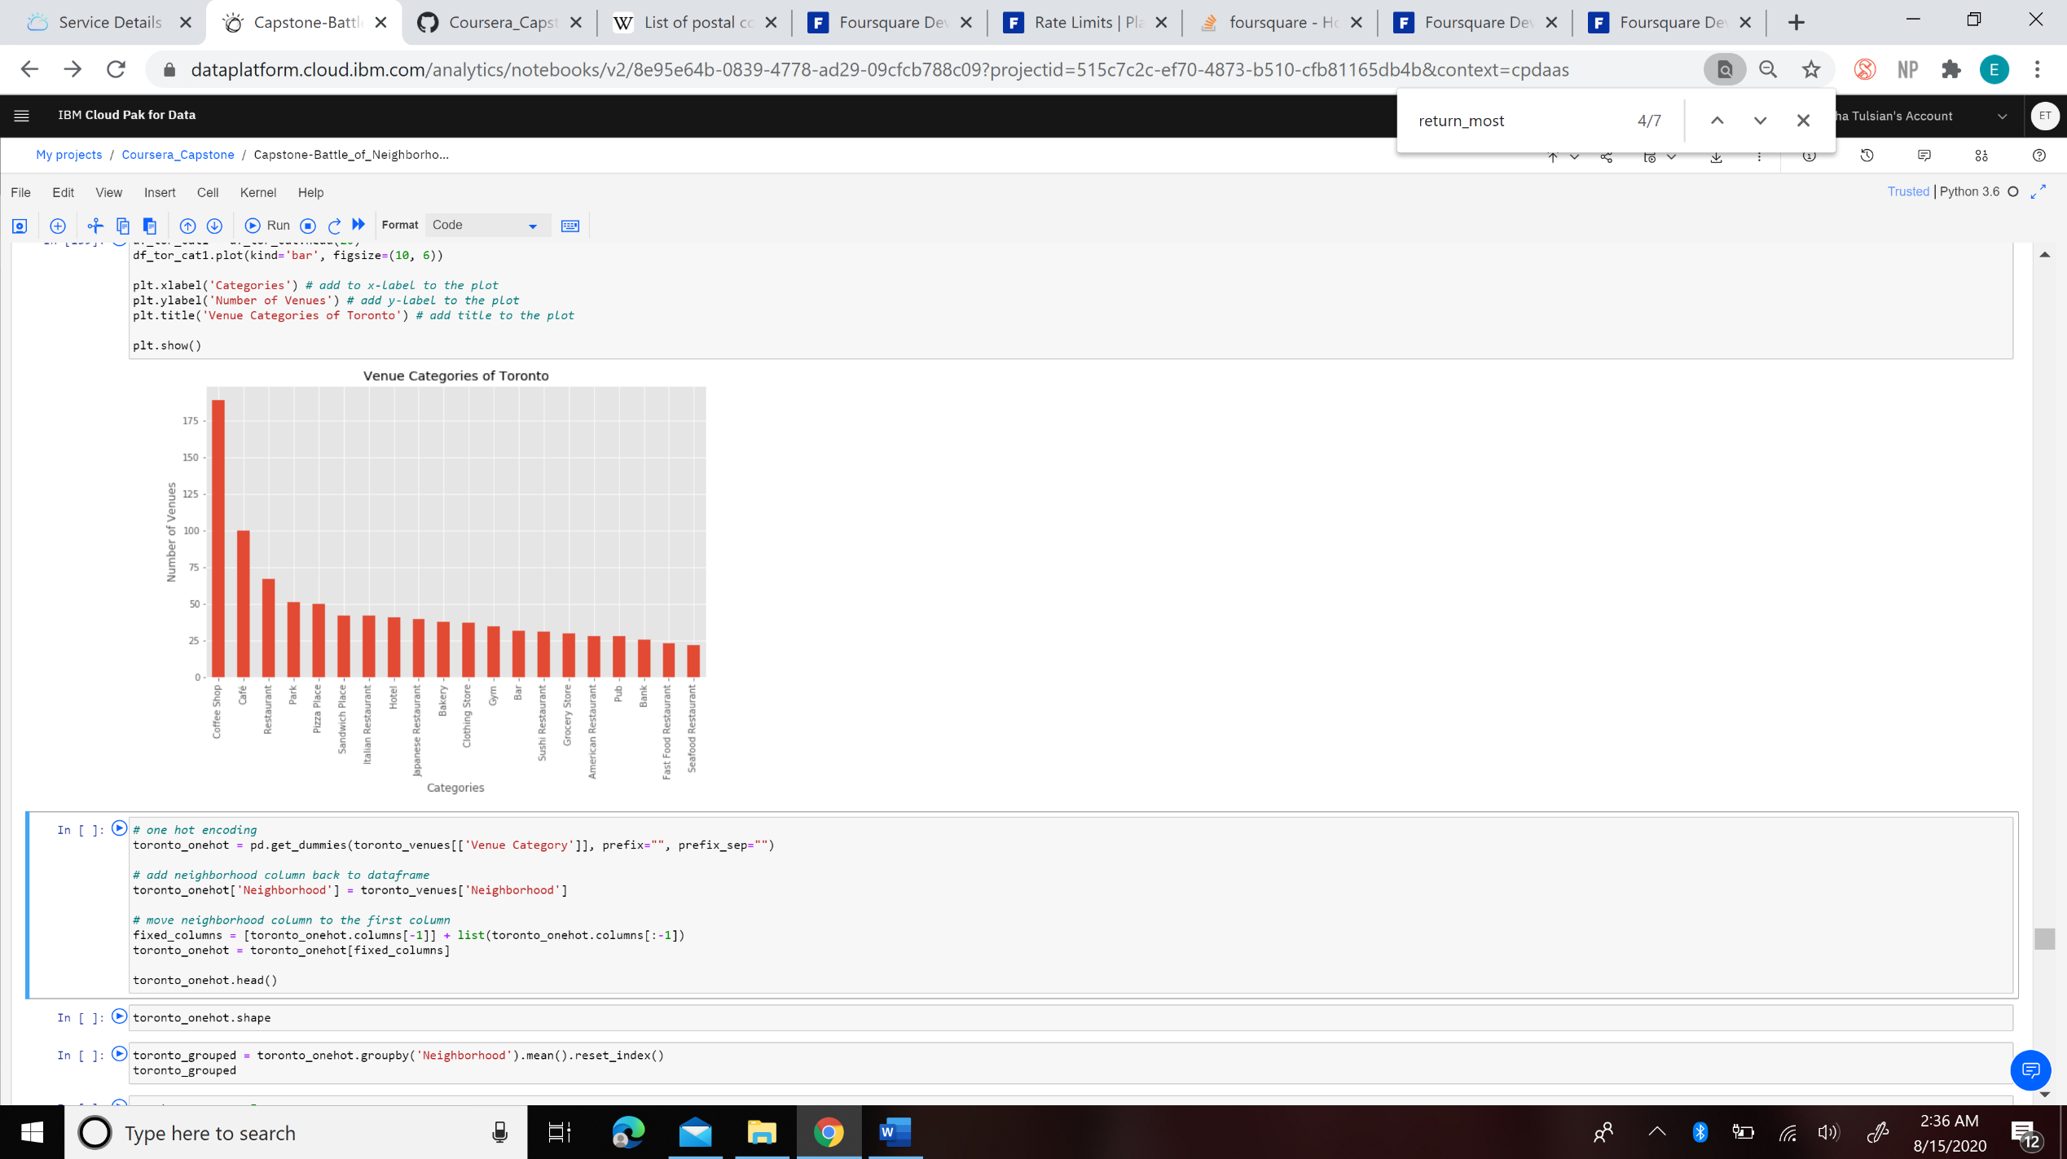
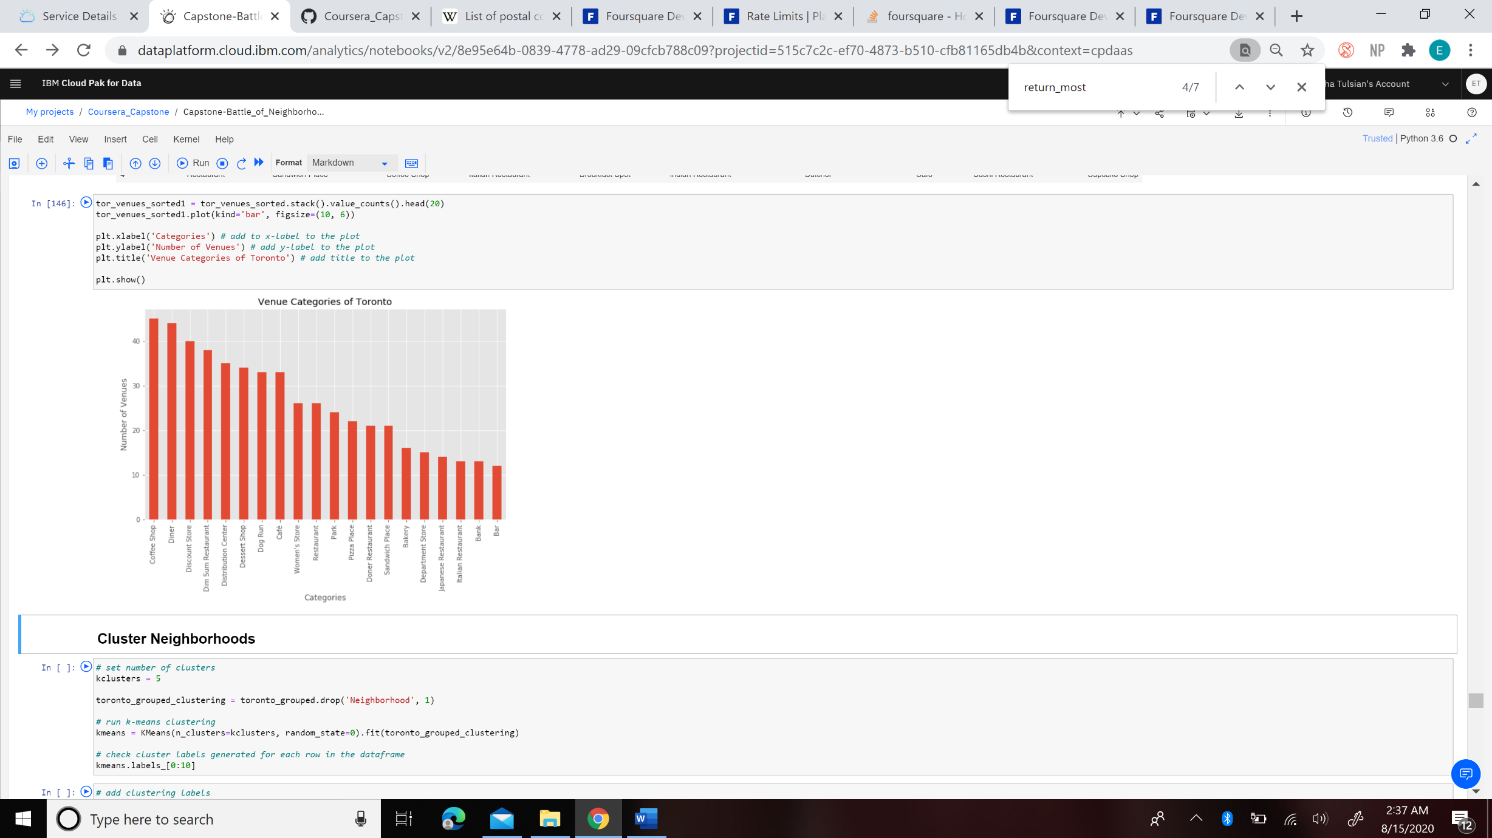
Toronto
Top 20 Most Common Overall Venue Types
Top 20 Venue Types after looking at Top 10 Venues of Each Neighborhood

Slide 19
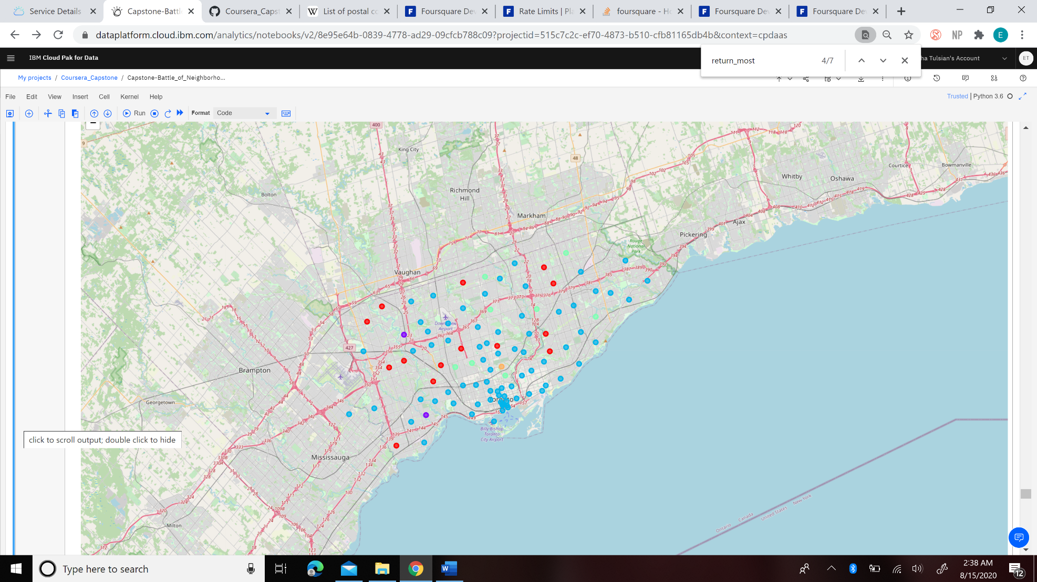
Toronto
Cluster 0
Red
14 Neighborhoods
Cluster 1
Purple
2 Neighborhoods
Cluster 2
Blue
74 Neighborhoods
Cluster 3
Green
8 Neighborhoods
Cluster 4
Orange
1 Neighborhood

Slide 20
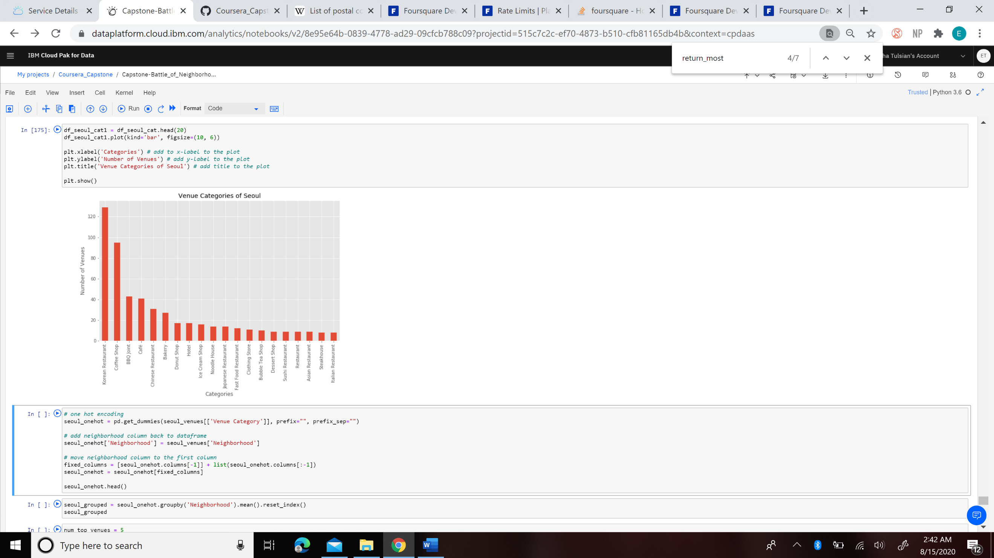
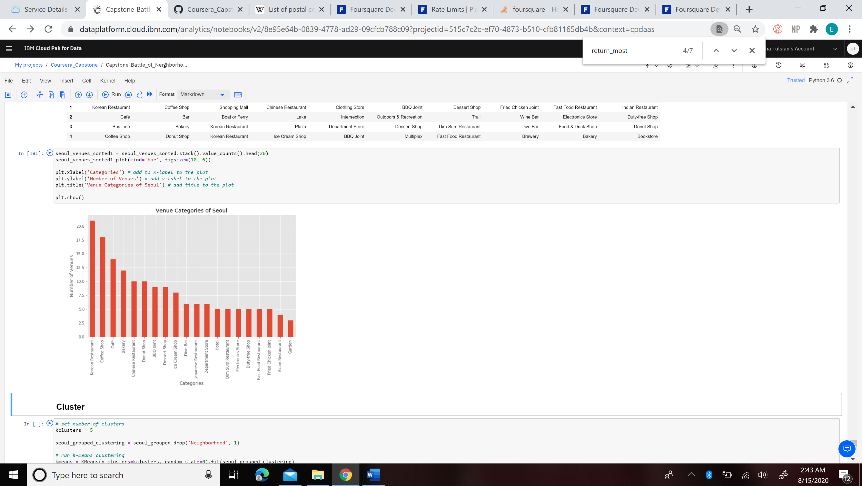
Seoul
Top 20 Most Common Overall Venue Types
Top 20 Venue Types after looking at Top 10 Venues of Each Neighborhood

Slide 21
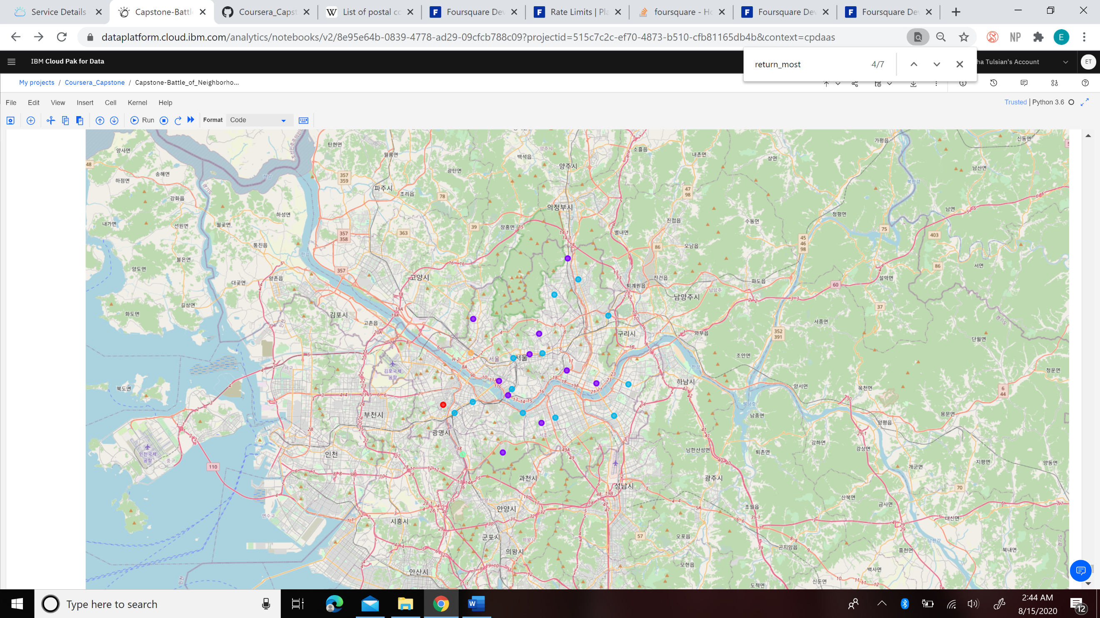
Seoul
Cluster 0
Red
1 Neighborhood
Cluster 1
Purple
10 Neighborhoods
Cluster 2
Blue
12 Neighborhoods
Cluster 3
Green
1 Neighborhood
Cluster 4
Orange
1 Neighborhood

Slide 22
Discussion
Coffee shops or cafes are frequented by all the cultures
Suggests that coffee shops are important in all 3 cultures
Provides for a small comfy place for customers to enjoy their coffee while doing work or socializing
Cultural Aspect: Though they all frequent them, it does not mean the décor of the coffee shop or items in the coffee shop are the same
For instance, in NYC, they have coffee shops like Starbucks. However, in Seoul, they have themed cafes based on popular cartoons or locations.
All the cities had one or more food and drink places as their top 3
Toronto: only city with a non-food venue - discount store
Shopping plays a big role in their culture
NYC: makes sense that pizza places, Italian restaurants, and deli/bodegas are frequented because NYC is known for its delicious pizza, pasta, and subs.
Seoul: more Korean restaurants as the general population is Korean. Korean food is known for having delicious BBQ, which is reflected by BBQ joints being frequented often as well.

Slide 23
Conclusion
The whole data science process was followed
The steps were identifying the business problem, specifying and cleaning data required, performing exploratory data analysis, performing machine learning by clustering, and analyzing the results
To answer the business question,
each city is different and the top venue categories reflect the culture
For instance, coffee shops are popular in all cities but decorations and menu items should be related to the culture

Slide 24
Thank You for your Time!!
Hope you enjoyed!

